Slide 1
WELCOME

Slide 2
Twitter Sentimental Analysis
By :- Mentor :-
Aman Singh (171500037) Juginder Pal Singh
Ayush Gupta (171500071) (Assistant Professor)

Slide 3
INTRODUCTION
So, what is Sentiment Analysis?

Slide 4
Sentiment Analysis
“Sentiment Analysis is the process of computationally identifying and categorizing opinions expressed in a piece of text, especially in order to determine whether the writer’s attitude towards a particular topic, brand, etc. is positive, negative or neutral.”

Slide 5
Twitter
“Twitter is an American online news and social networking service developed in March 2006 by Jack Dorsey, Noah Glass, Biz Stone and Evan Williams.”

Slide 6
186 Million
Whoa! That’s a big number!
This is the total number of active twitter users in 2020.

Slide 7
711,000,000$
500,000,000
80%
That’s a lot of money
Tweets sent per day
Twitter users on mobile

Slide 8
The process is easy
PRE-PROCESSING
MAKING MODEL
EVALUATION
SENDING QUERY
PREDICTION
RESULTS

Slide 9
DATASETS & PRE-PROCESSING
So, what is pre-processing and why do we need to do it?

Slide 10
Datasets
“Many labeled sentiment datasets have been created, especially for Twitter posts & Amazon product reviews.
Apart from using these datasets, a user can create a dataset by crawling using twitter API.”

Slide 11
Datasets
Stanford Twitter Sentiment
Sentiment Strength Twitter Dataset
Amazon Reviews for Sentiment Analysis
Sanders Corpus

Slide 12
Pre-Processing
“Data pre-processing is a data mining technique that involves transforming raw data into an understandable form.”

Slide 13
Pre-Processing
Noice Reduction
Removing numbers
Removing punctionations
Removing stop words

Slide 14
PREDICTING SENTIMENTS
So, how to predict sentiments?

Slide 15
Algorithms Used
Logistic Regression
Multinomial Naïve Bayes Theorem
Stochastic Gradient Descent
Voting classifier

Slide 16
Here, we have used Voting Classifier of Ensemble Technique using 3 base classifiers – Logistic Regresion, Multinomial Naïve Bayes and Stochastic Gradient Descent

Slide 17
DEPLOYING MODEL ON WEB
So, how to predict sentiments in real time?

Slide 18
Model Deployment
Here, I have used Flask to deploy the model.
The trained models are used at backend, queries are fired at front end.
The Flask app is hosted at Heroku and the domain is at Hostinger.

Slide 19
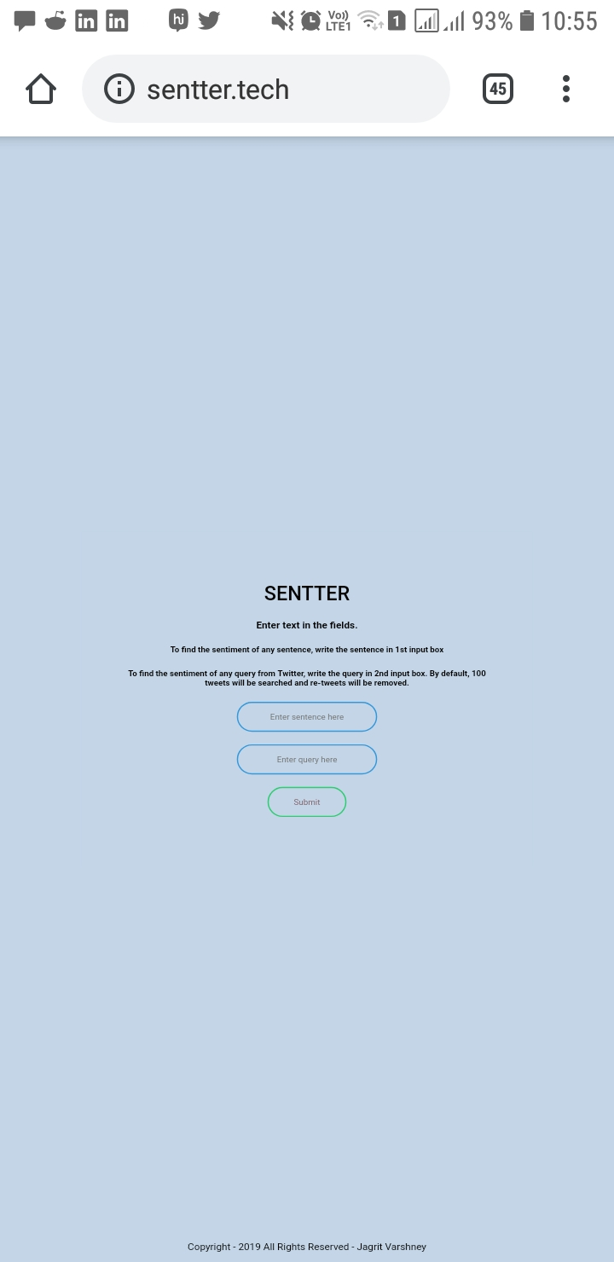
MOBILE VIEW

Slide 20
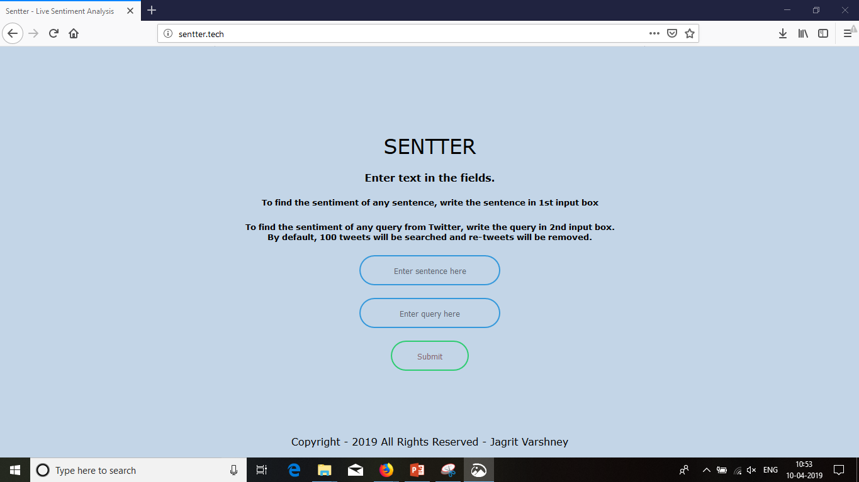
DESKTOP VIEW

Slide 21
www.sentter.tech
You can find the sentiment analysis tool here

Slide 22
CONCLUSION
So, what is the result of all this that we have done?

Slide 23
Mainly divided into three categories
And it can be furthur divided to various other sentiments in future.

Slide 24
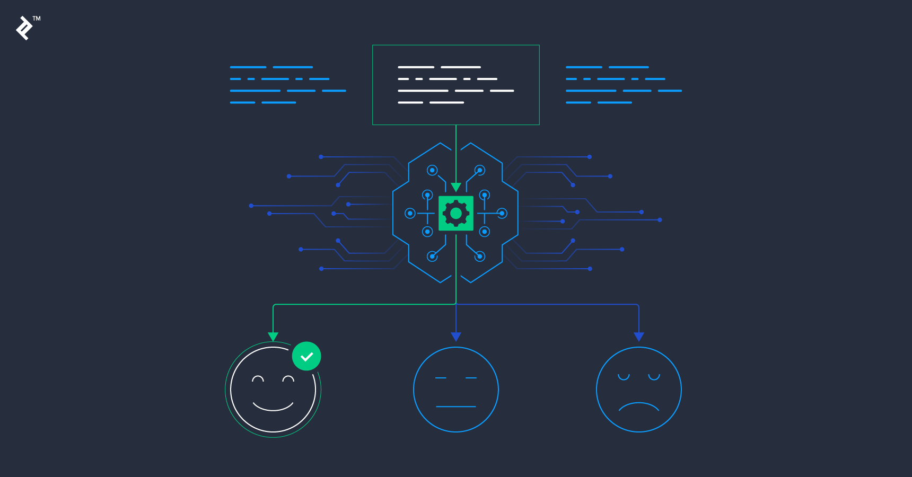

Slide 25
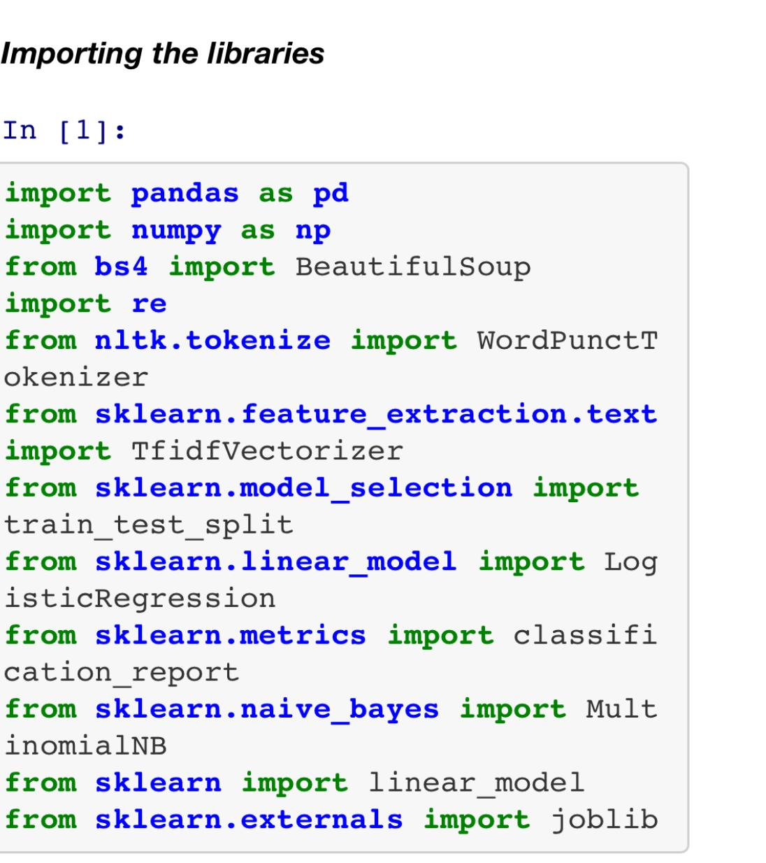

Slide 26
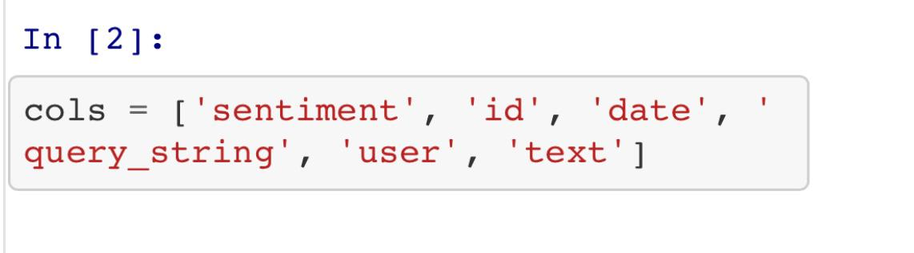

Slide 27
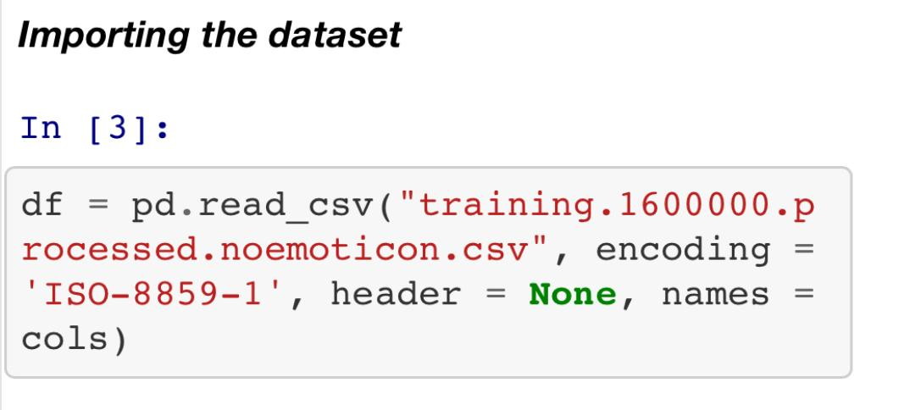

Slide 28
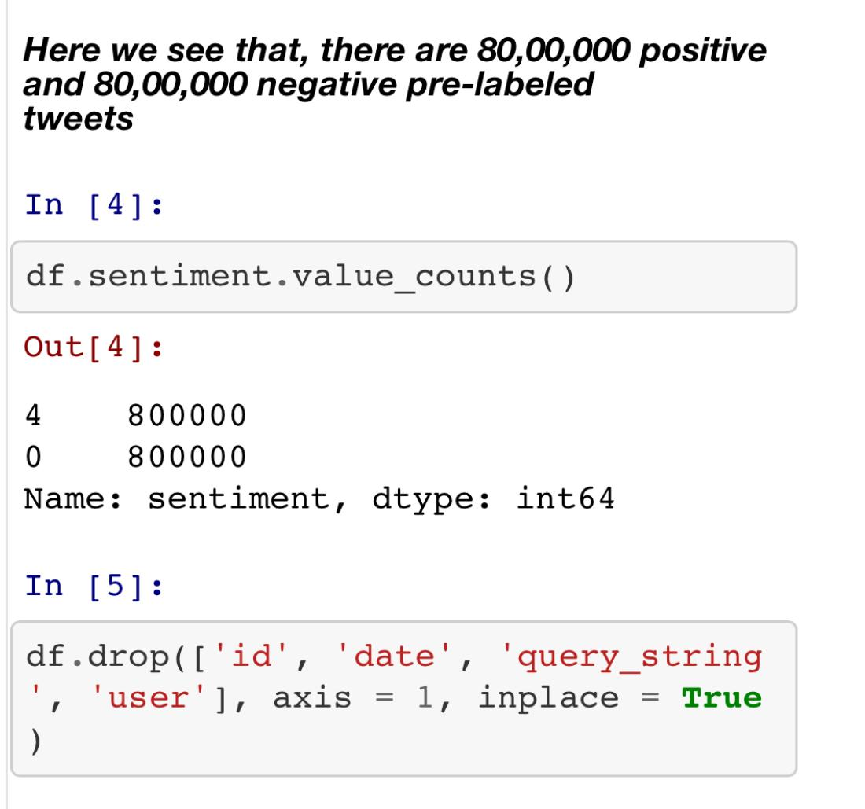

Slide 29
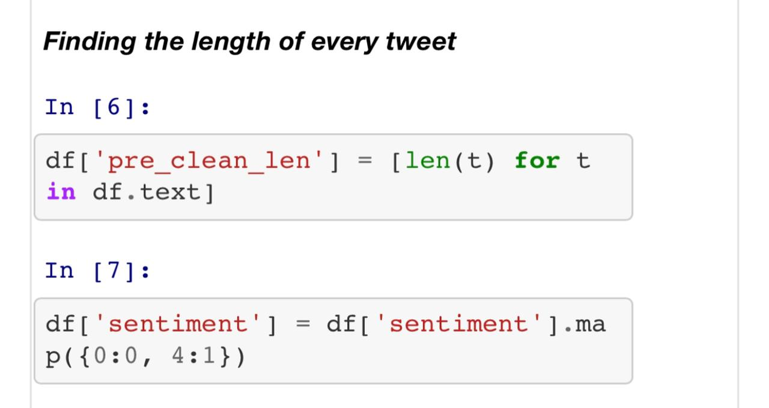

Slide 30
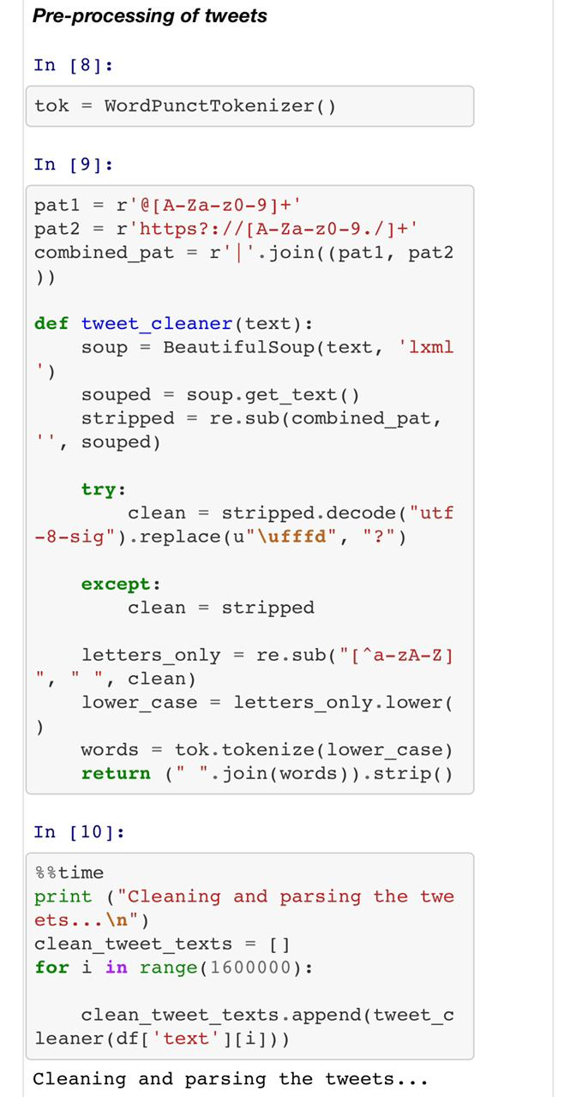

Slide 31
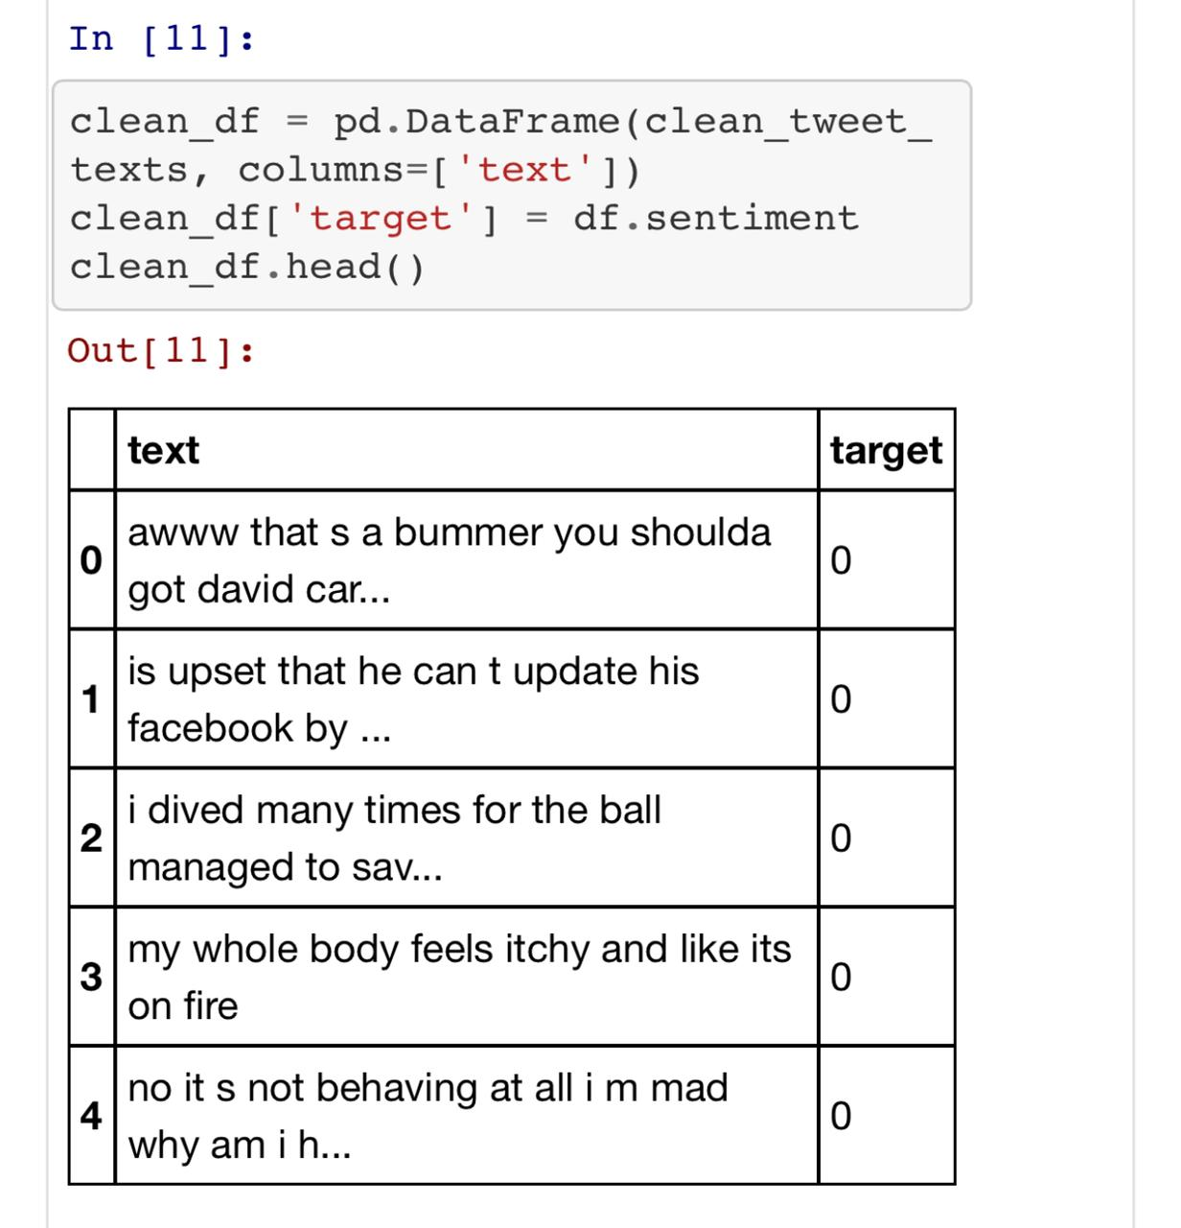

Slide 32
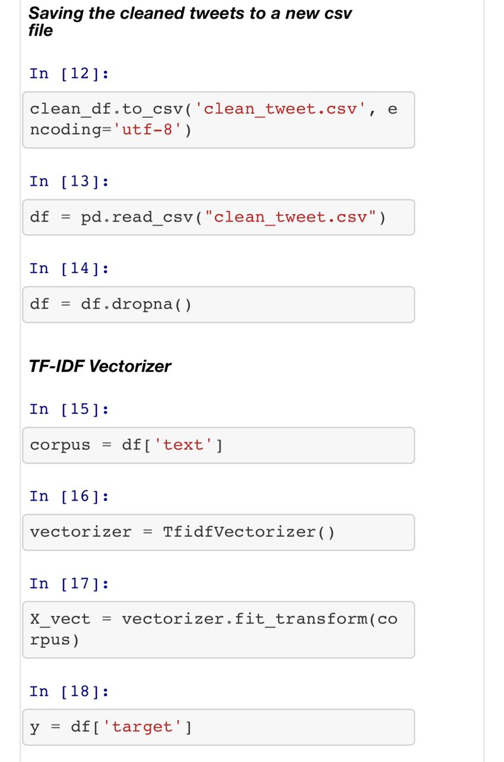

Slide 33
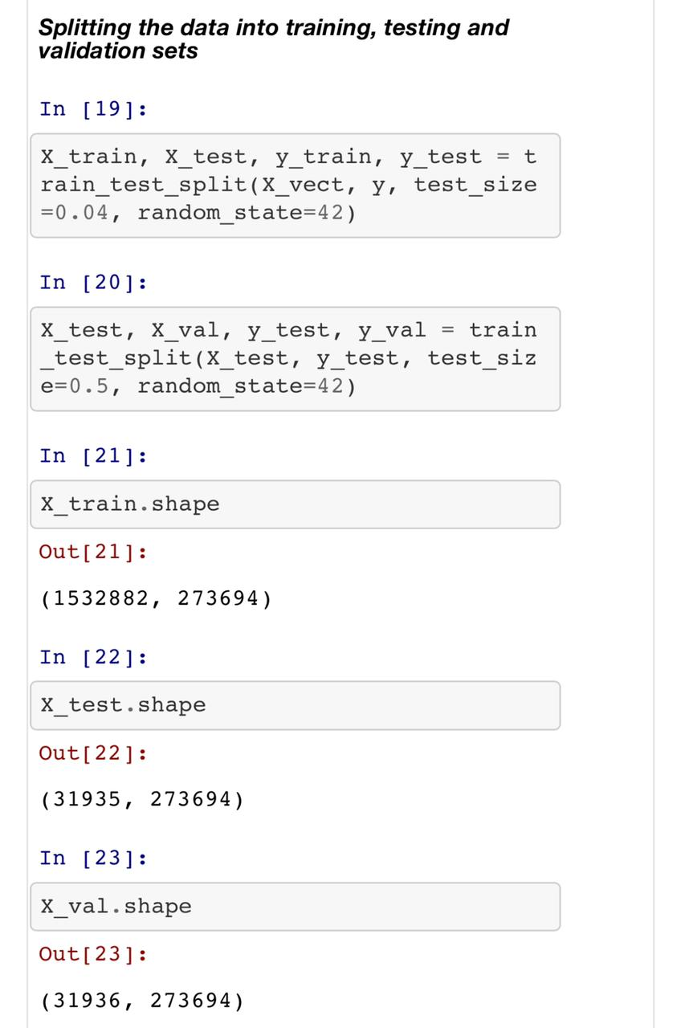
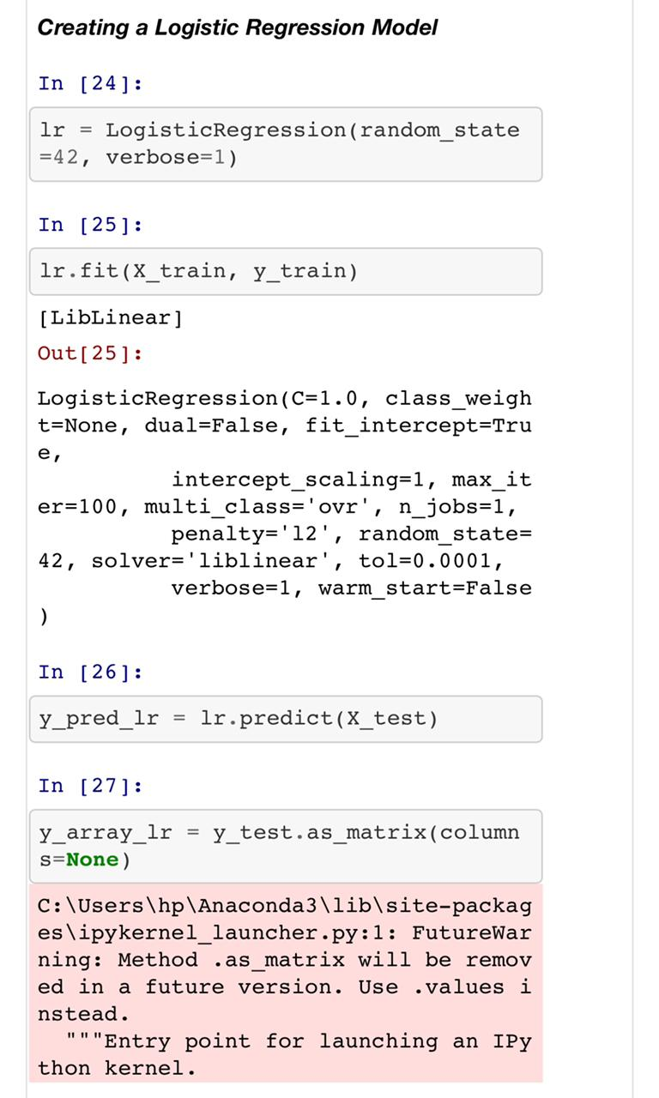

Slide 34
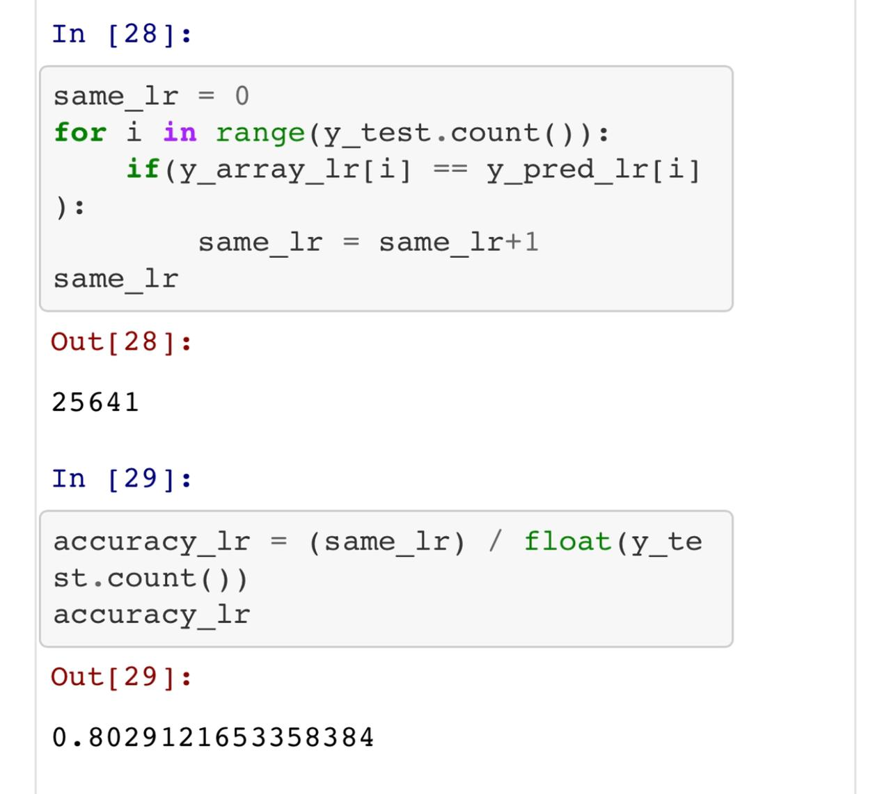
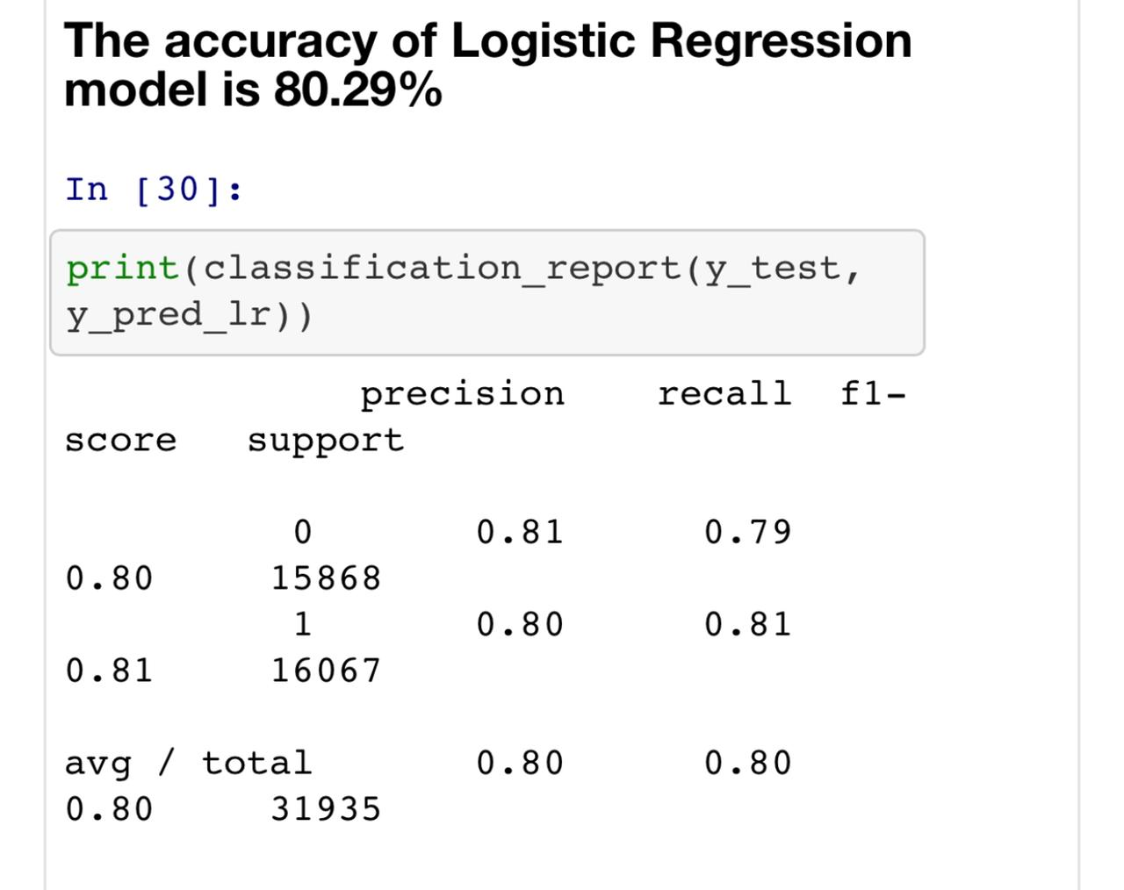

Slide 35
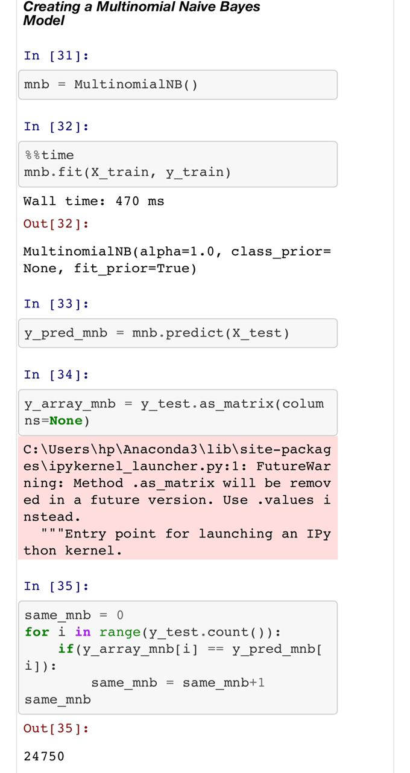
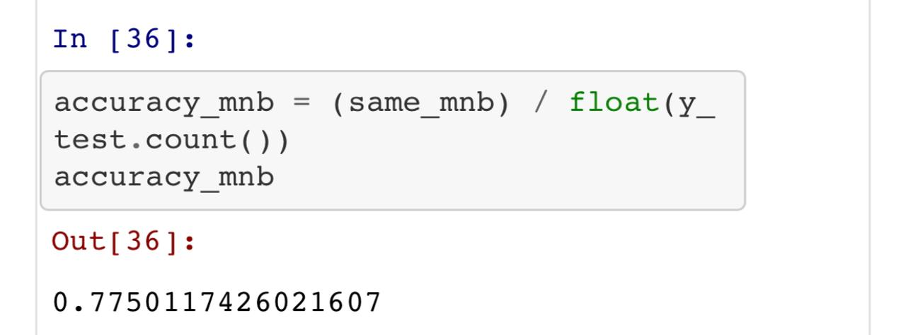

Slide 36
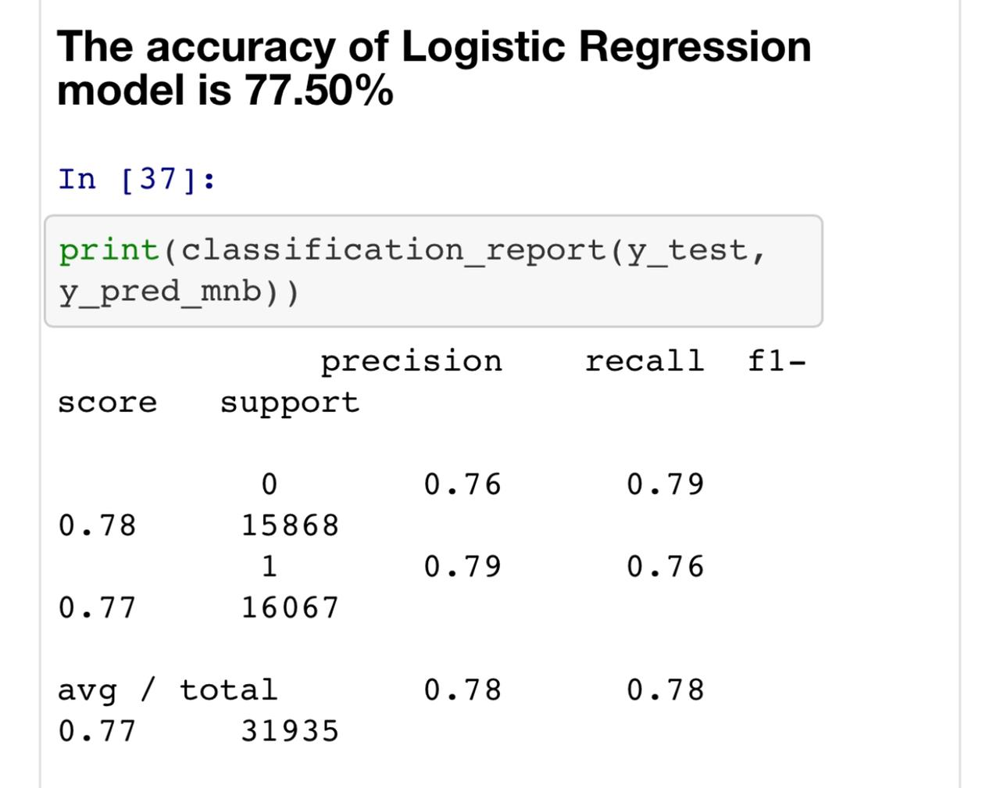
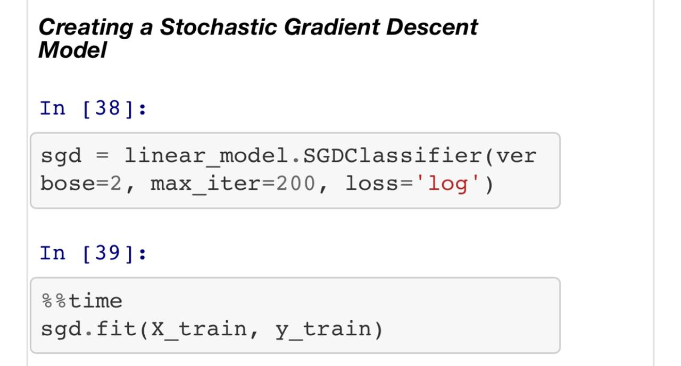

Slide 37
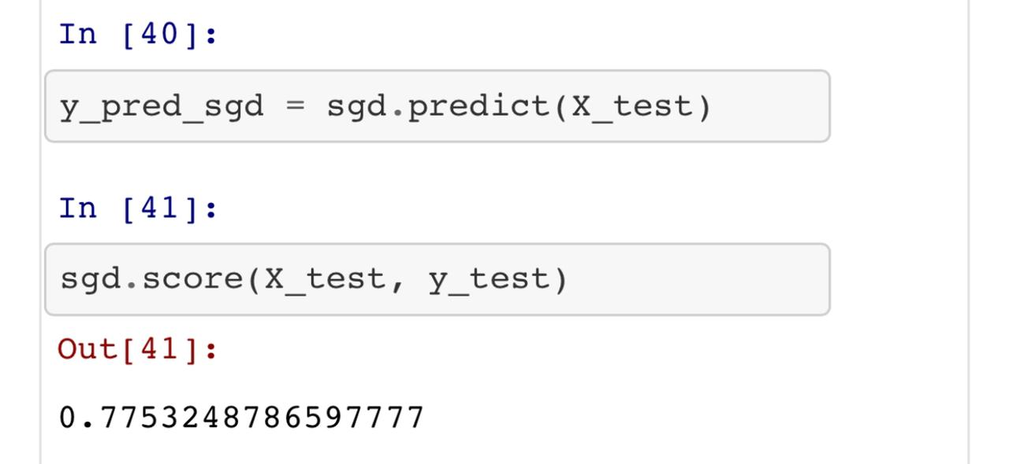
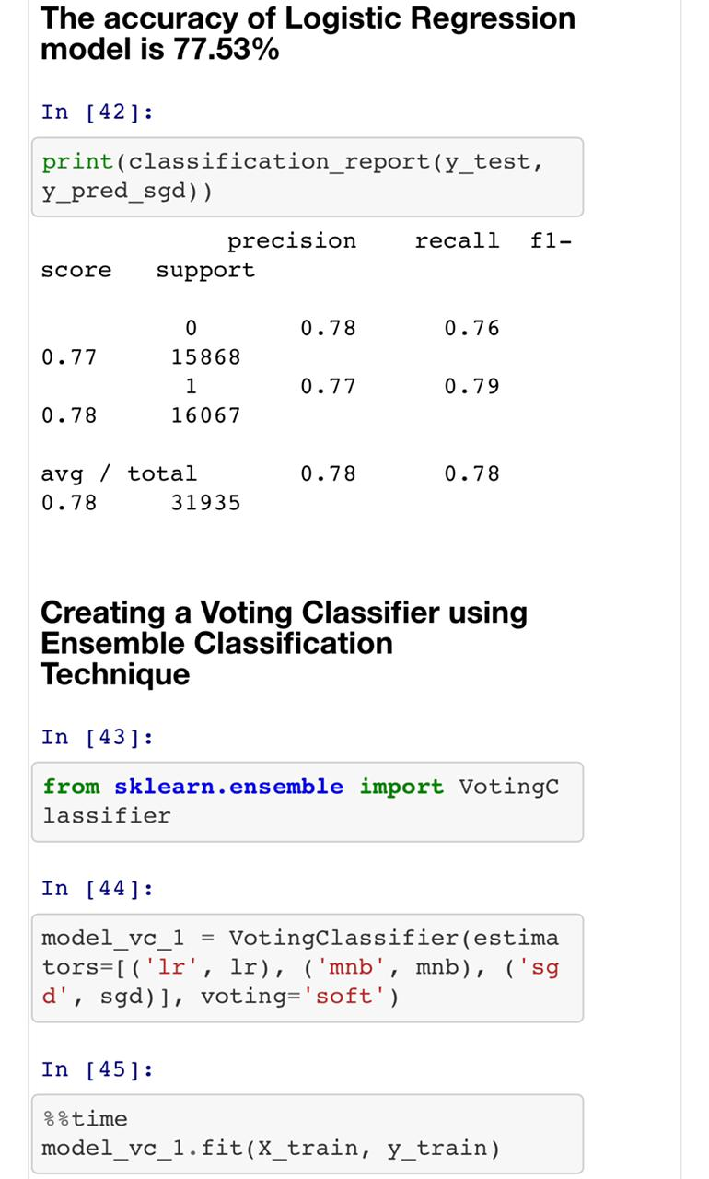

Slide 38
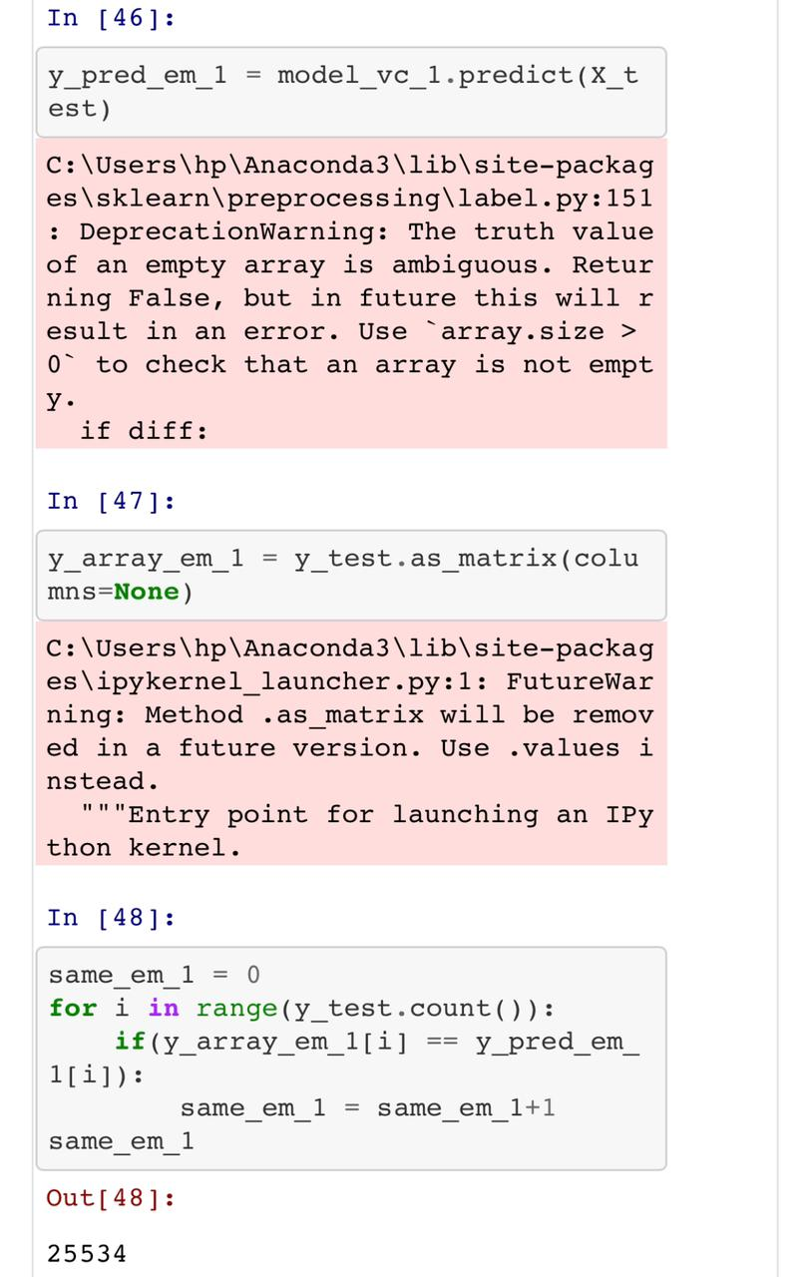
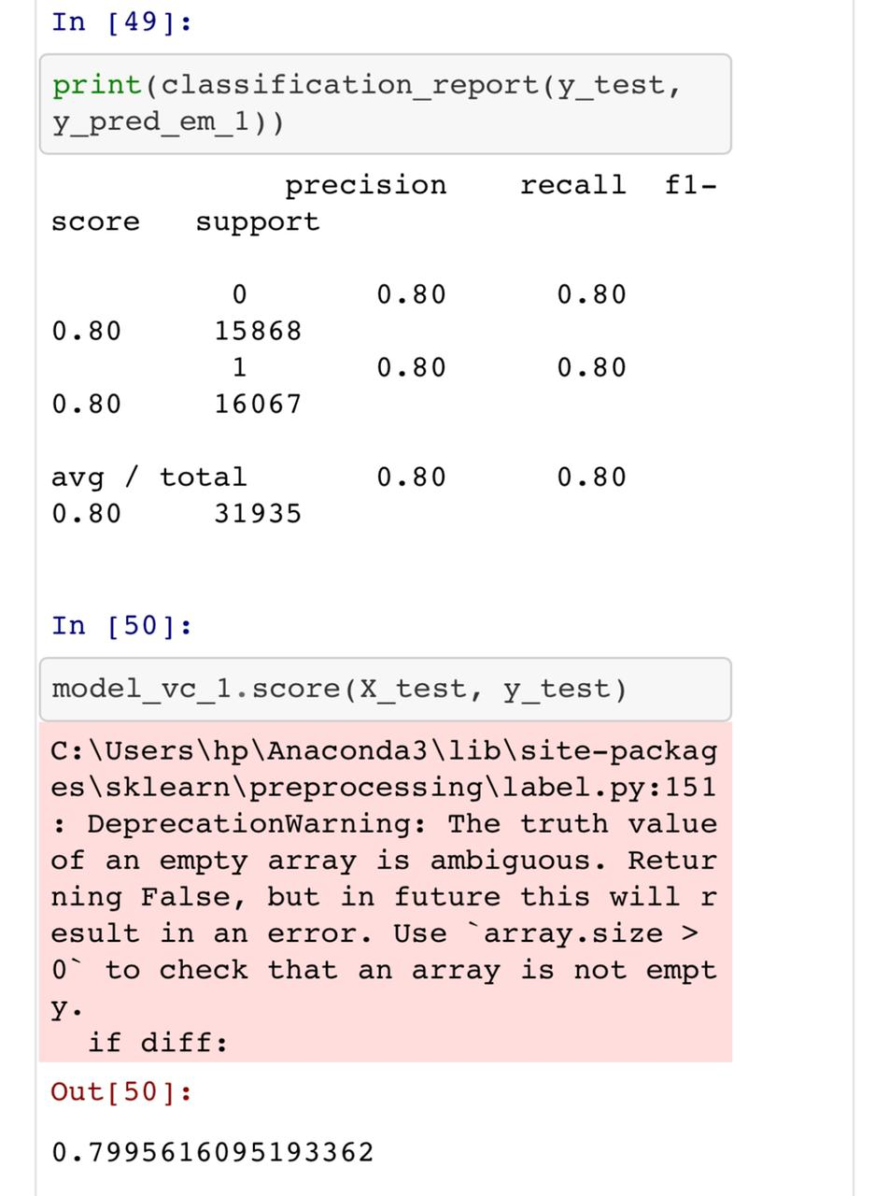

Slide 39
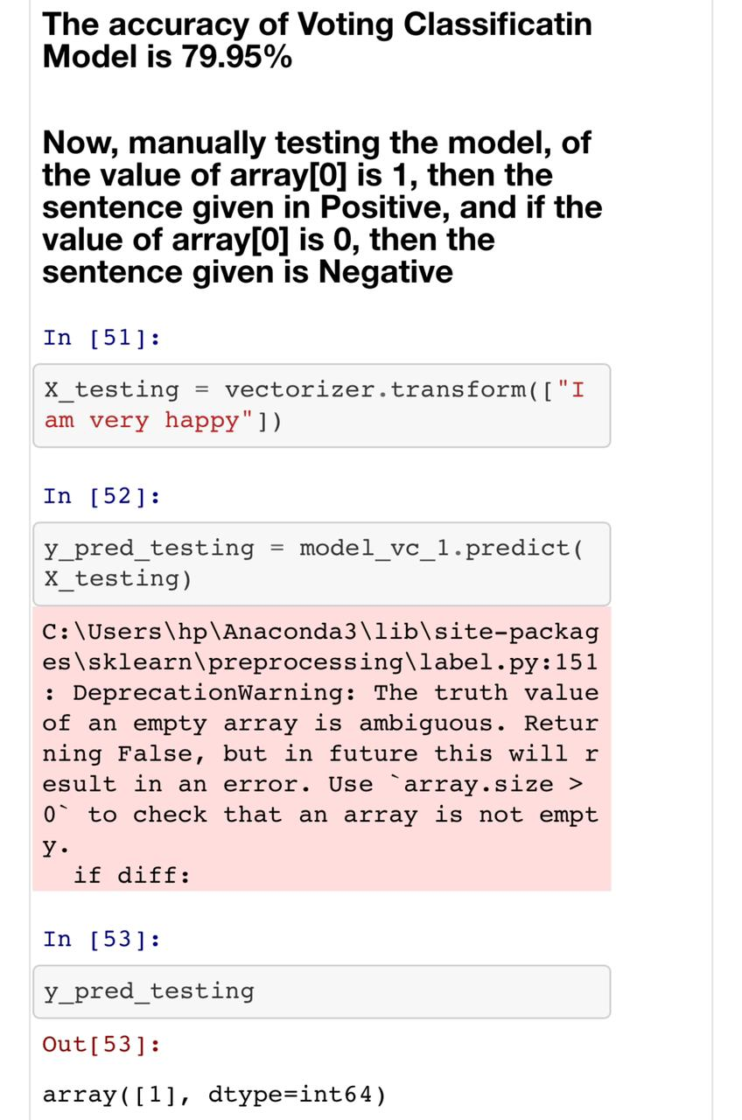

Slide 40
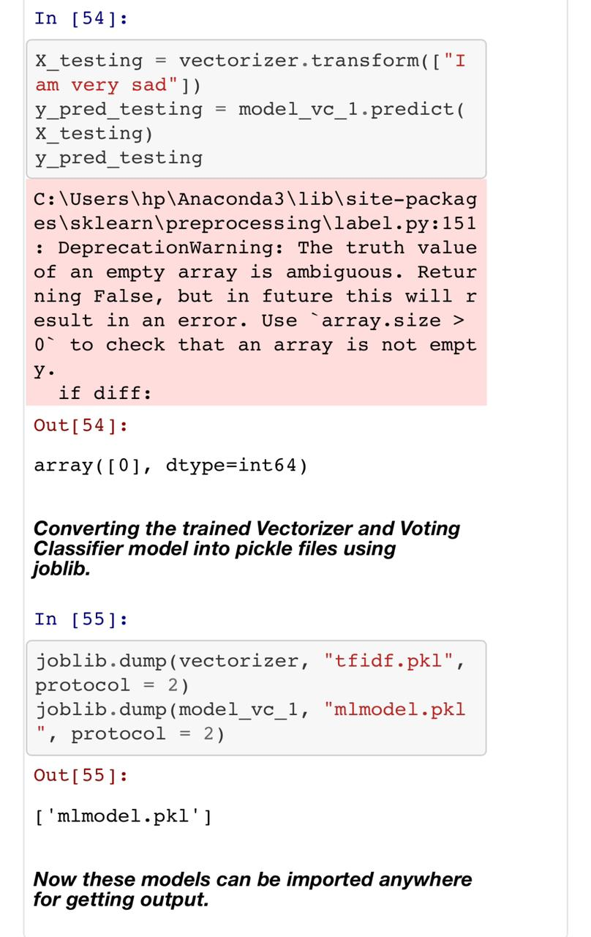

Slide 41
THANKS!
Any questions?
You can find us at:
LinkedIn - https://www.linkedin.com/in/ayushguptaag/
Github - https://github.com/ayush852/

